Slide 1
State of Cybersecurity Pathways in IL
April 28th, 2022
Juan Jose Gonzalez.
Notes:
MM

Slide 2
The EdSystems Mission Shape and strengthen education and workforce systems to advance racial equity and prepare more young people for productive careers and lives in a global economy.
Statewide
Community Networks
College &
Career Pathways
Bridges to
Postsecondary
Data Impact &
Leadership
Innovation
Notes:
JON

Slide 3
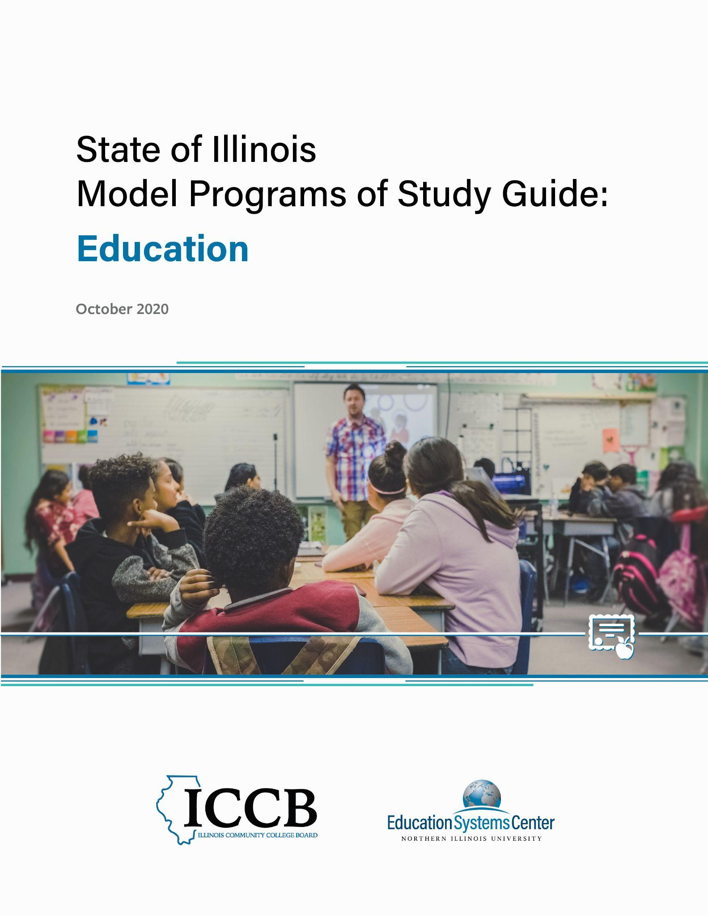
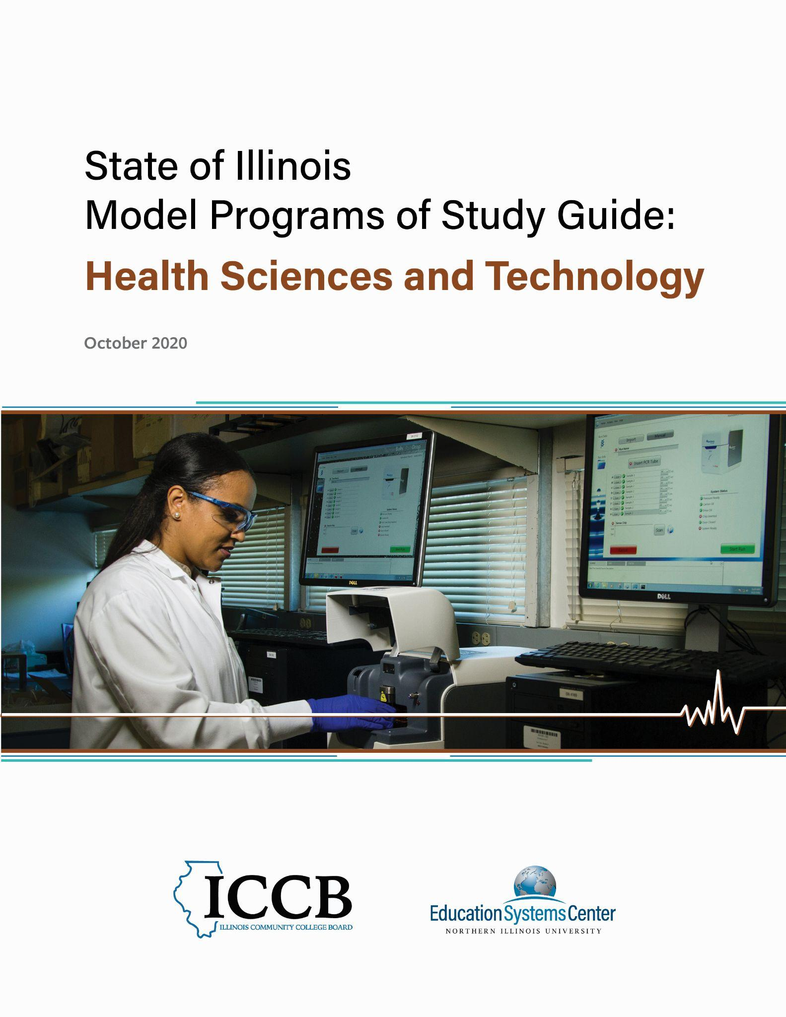
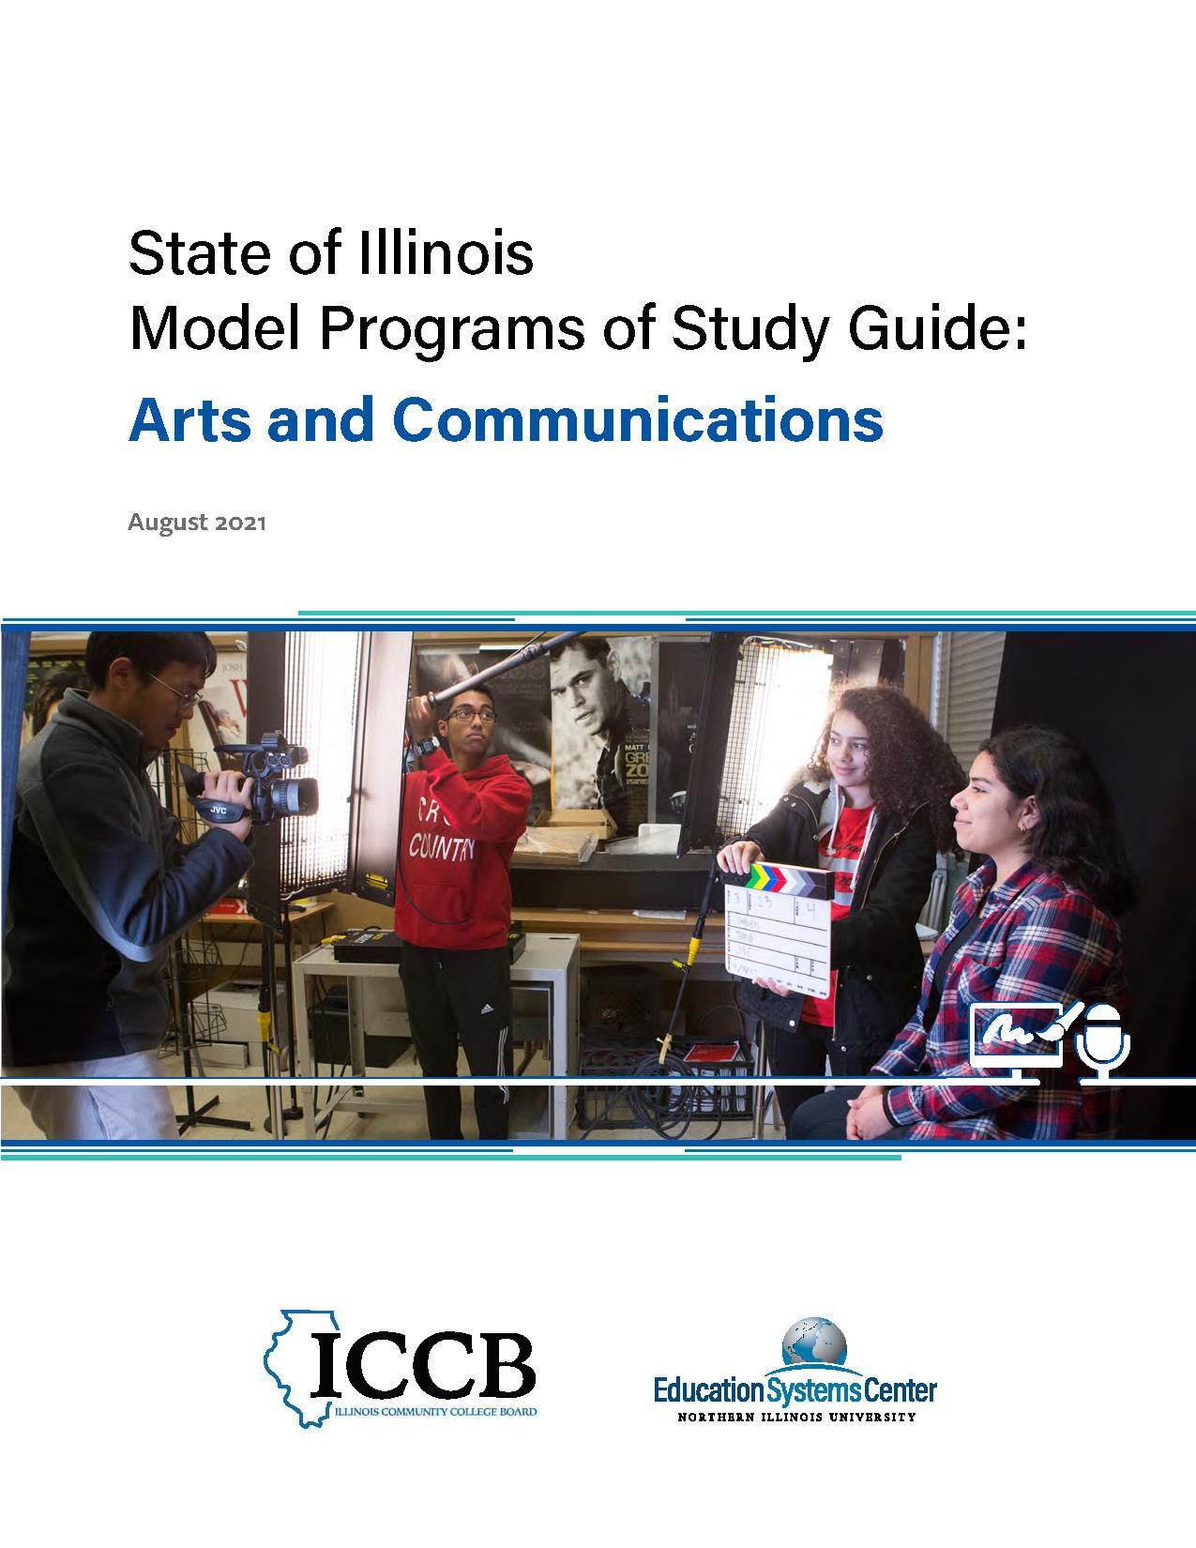
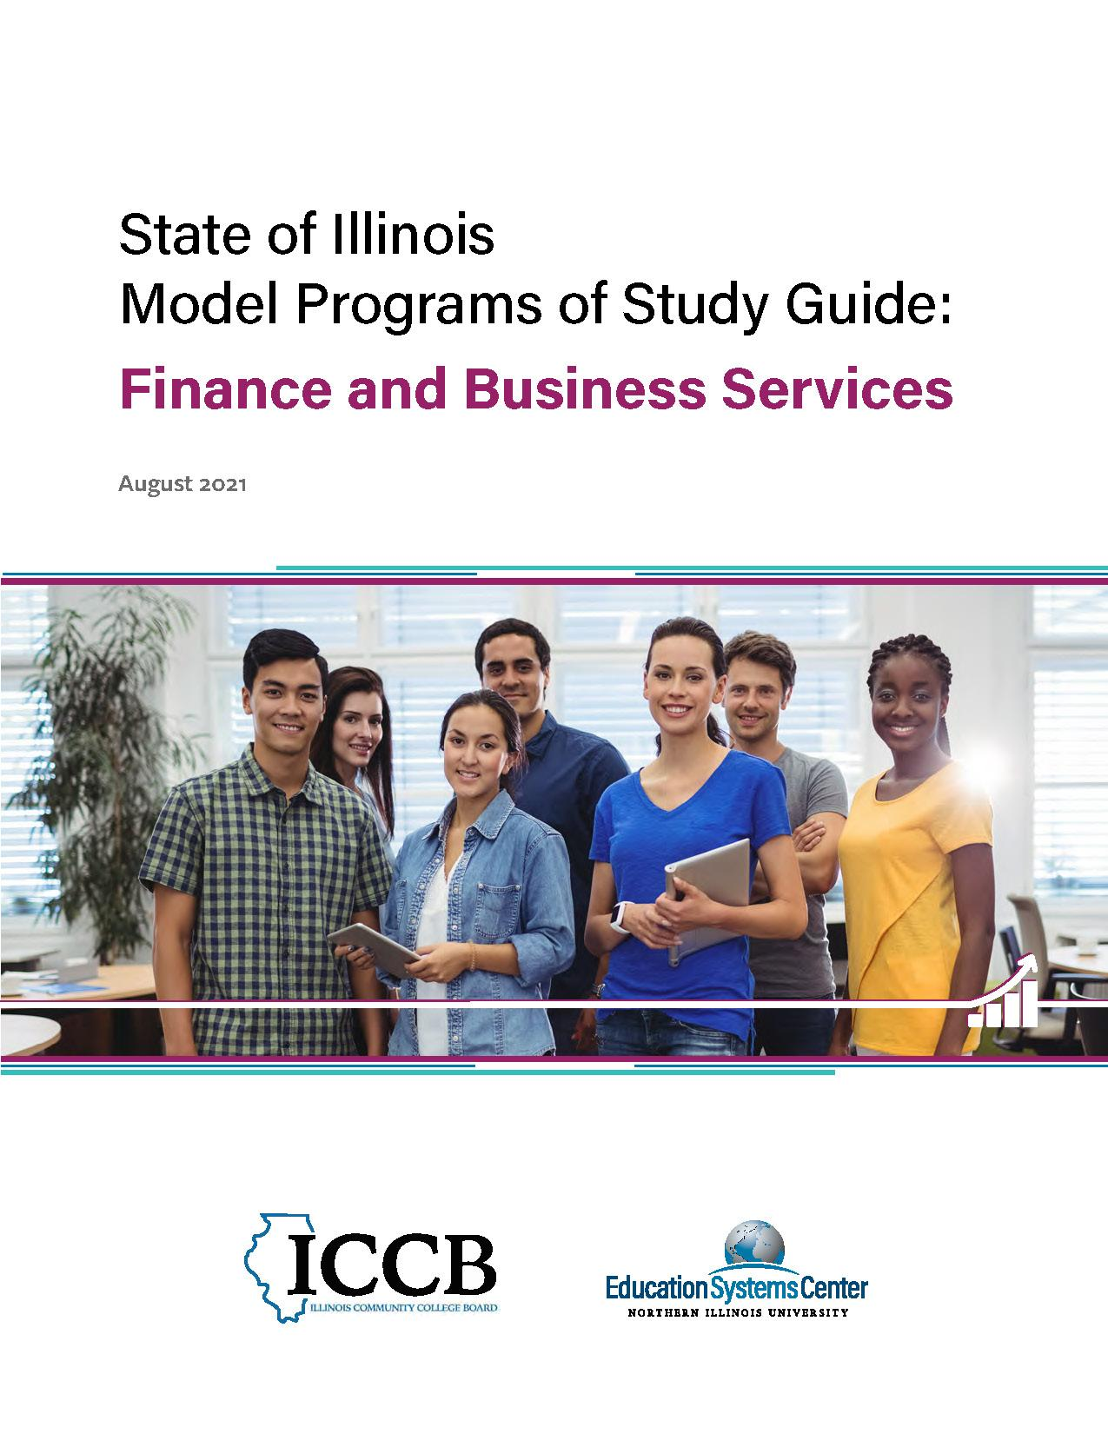
Model Programs of Study Guides
Education
Health Sciences
Information Technology
Manufacturing and Engineering
Agriculture, Food and Natural Resources
Architecture, Construction and Energy
Arts and Communications
Finance and Business Services
edsystemsniu.org/guides

Slide 4
Statewide Model Programs of Study
Intended audiences:
High school faculty working in pathways
Community College faculty and staff (e.g. academic deans & department heads, early college liaisons, etc.)
Education for Employment System Directors
Notes:
JJG

Slide 5
High Priority Occupations & Promising Credentials
Using Department of Labor data and the MIT Living Wage Calculator for the State of Illinois as a reference, High Priority Occupation defined
Occupations with a positive growth outlook and
Occupations whose salaries are near or greater than the “Living Wage” of 1 Adult + 1 Child in Illinois.
A “promising credential” is a degree or college certification that immediately prepares an individual for entry into a high-priority occupation, with a focus on credentials available in typical Illinois Community College.
Credential may also be is a clear precursor to or stackable credential for a high-priority occupation
Notes:
MM

Slide 6
Review of the Information Technology Guide
Notes:
JJG

Slide 7
Notes:
JJG
Overall Map

Slide 8
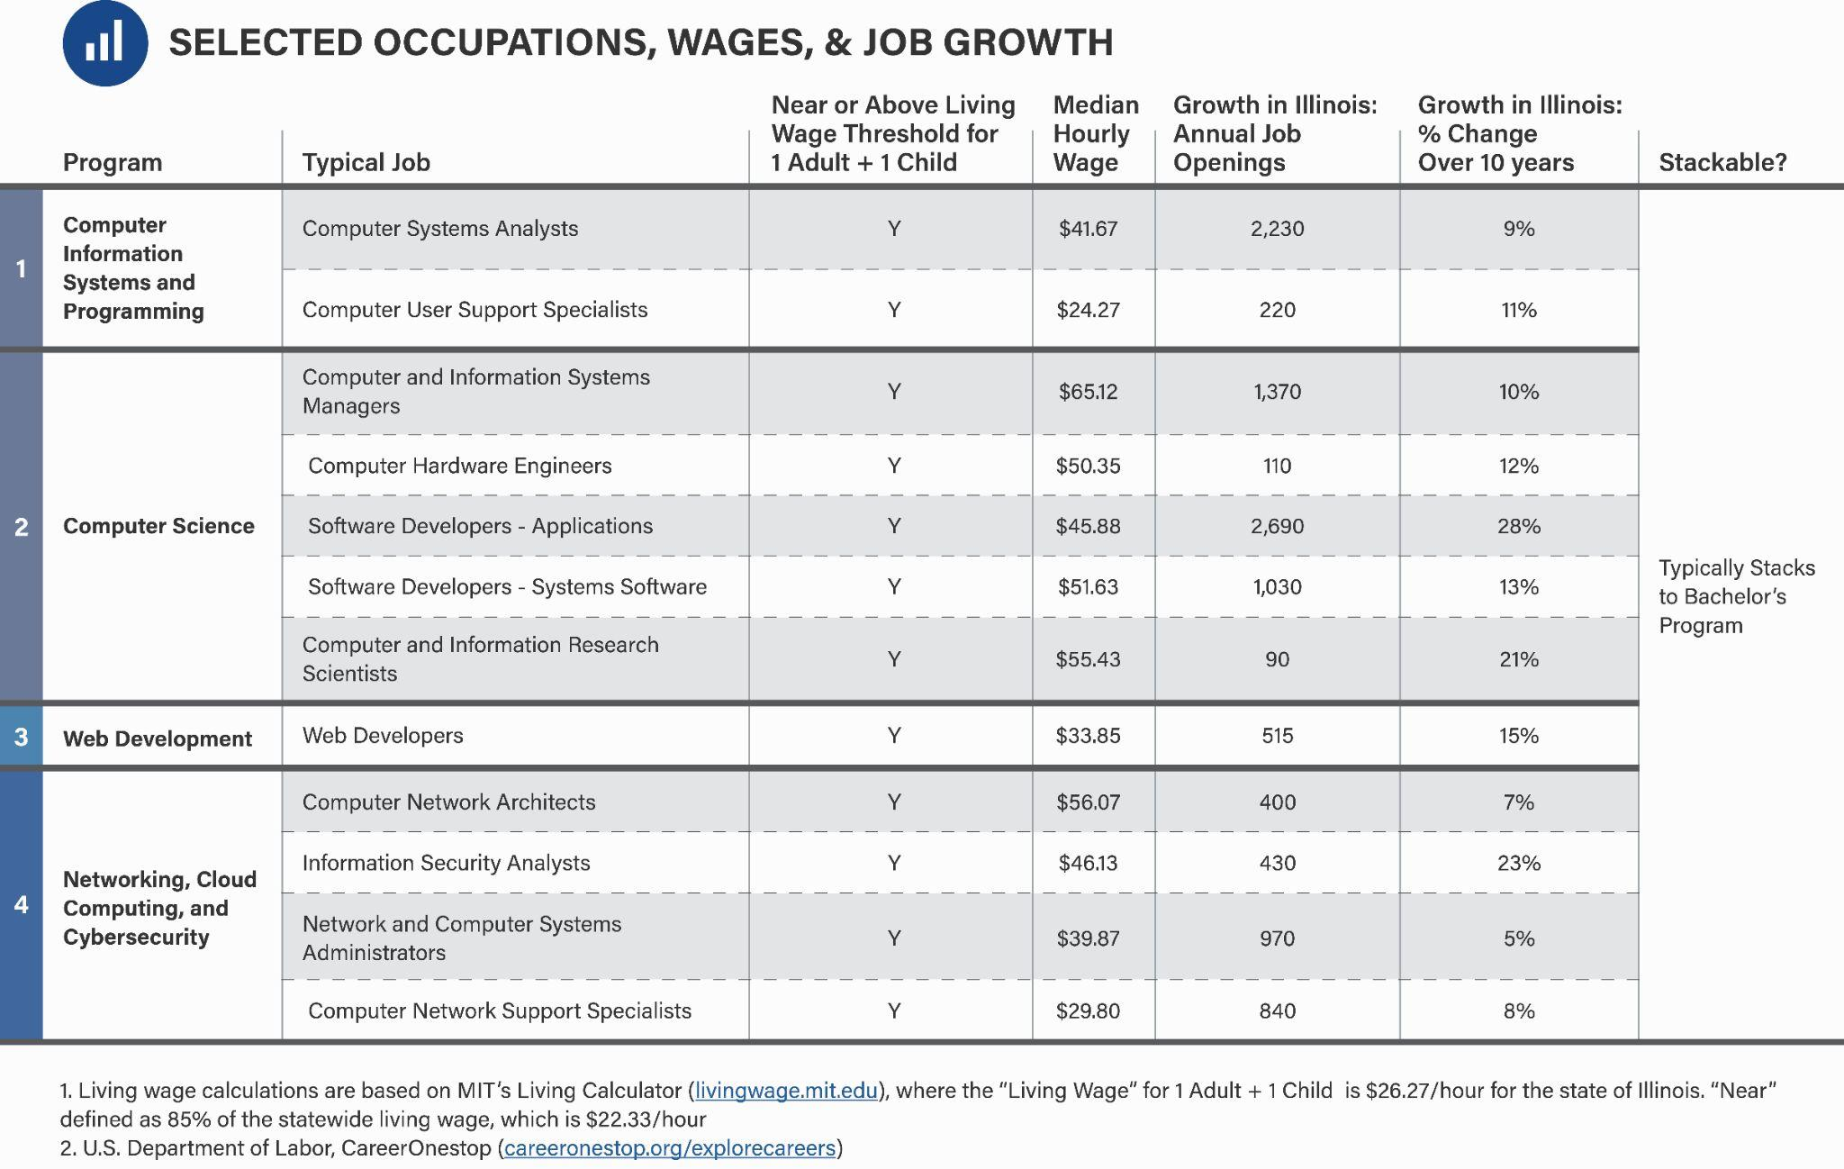
Notes:
JJG
Selected High Priority Occupations

Slide 9
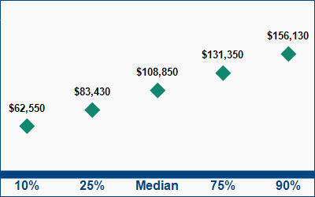
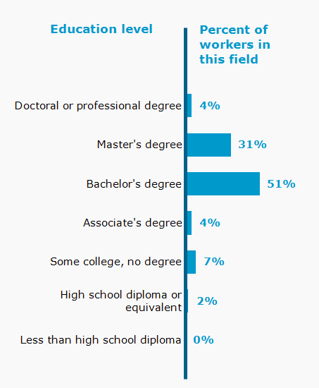
Information Security Analysts in IL - Deep Dive
People starting in this career usually have:
Bachelor's degree
No work experience
No on-the-job training

Slide 10
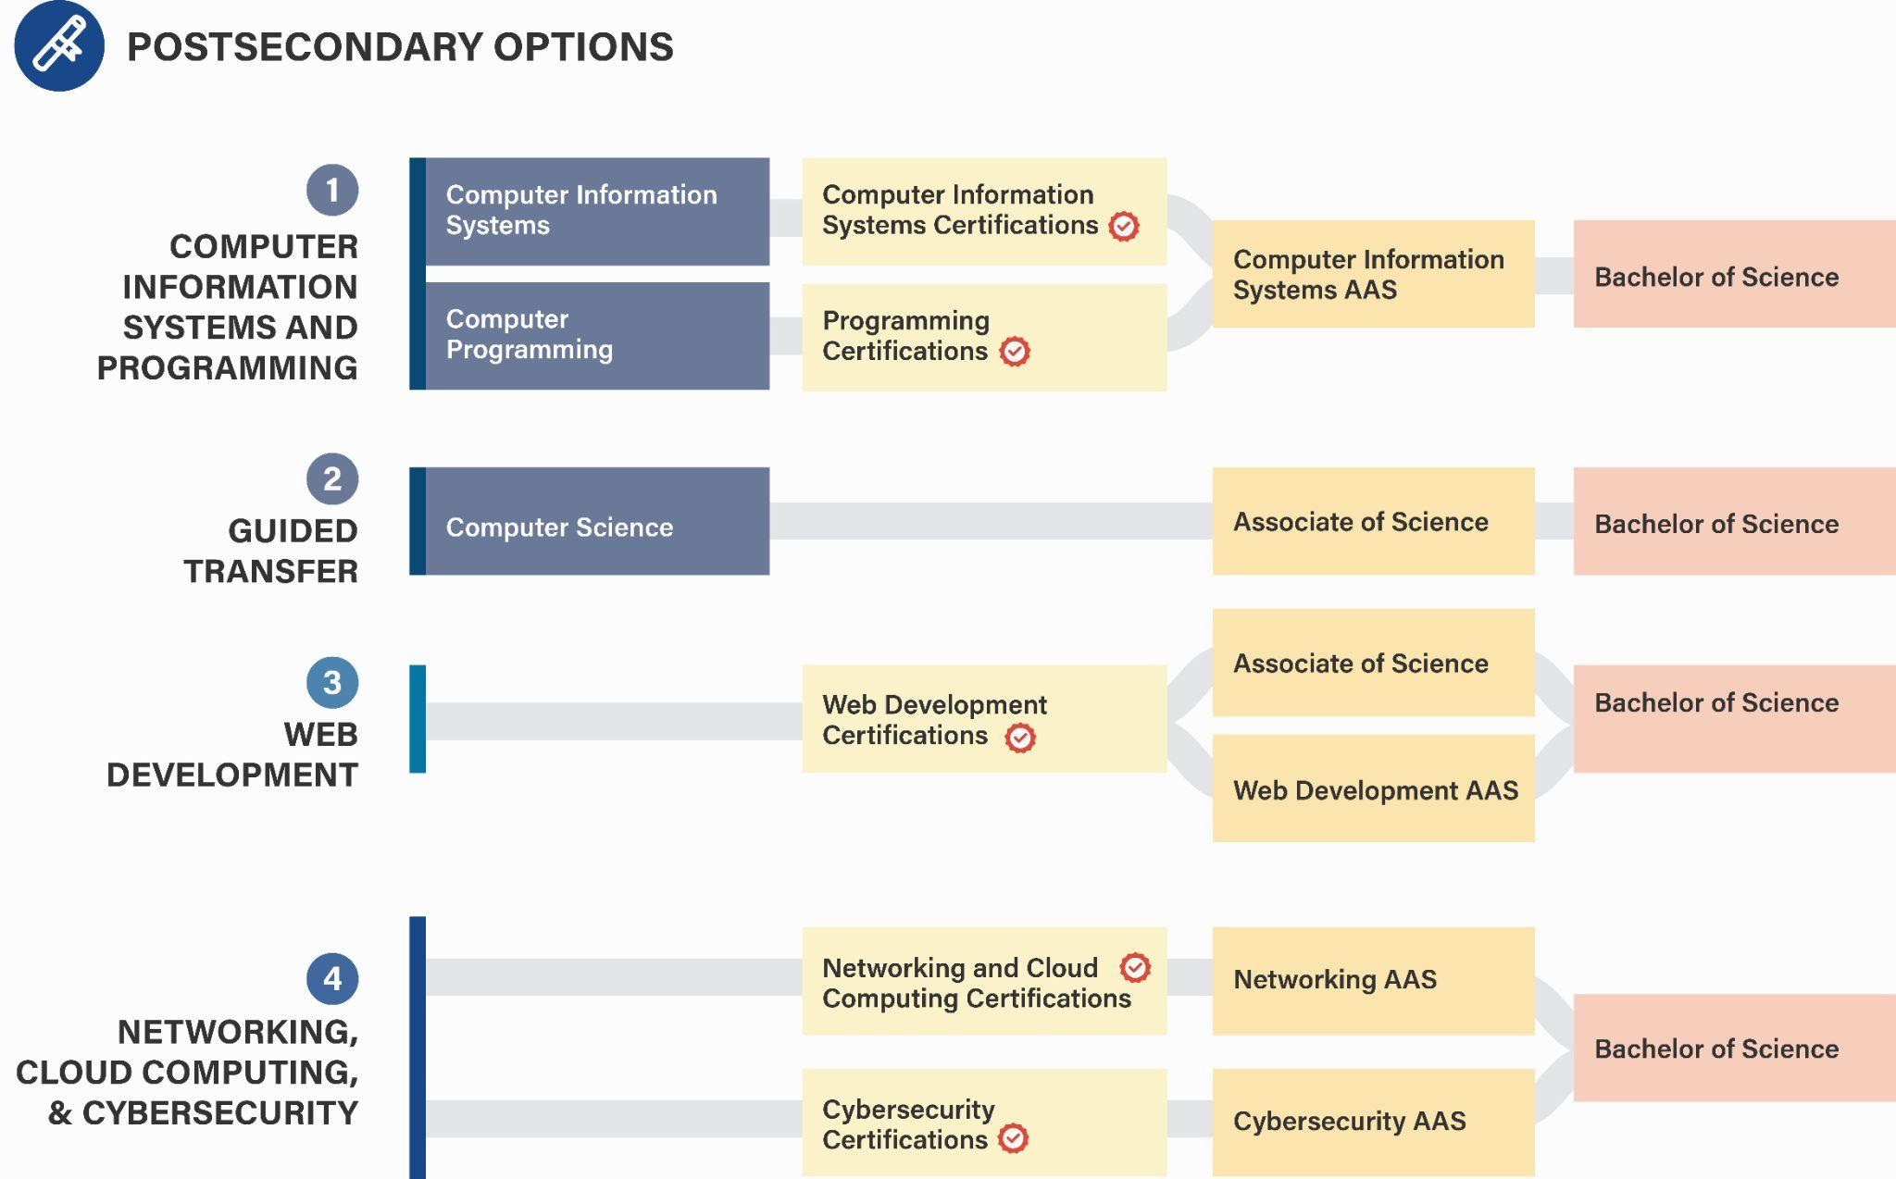
Notes:
JJG
Promising Credential programs available at several Community Colleges

Slide 11
ICCB Data on IT Programs (2019)
New programs added in 2020-21 in CCC
58 Programs with Forensics, Security/Secure, or Cybersecurity in Program Title
~ 38 Certificate, 23 AAS Degree programs
~ 23 AAS Degree programs

Slide 12
Illinois Postsecondary Profiles
Information Security Analysts

Slide 13
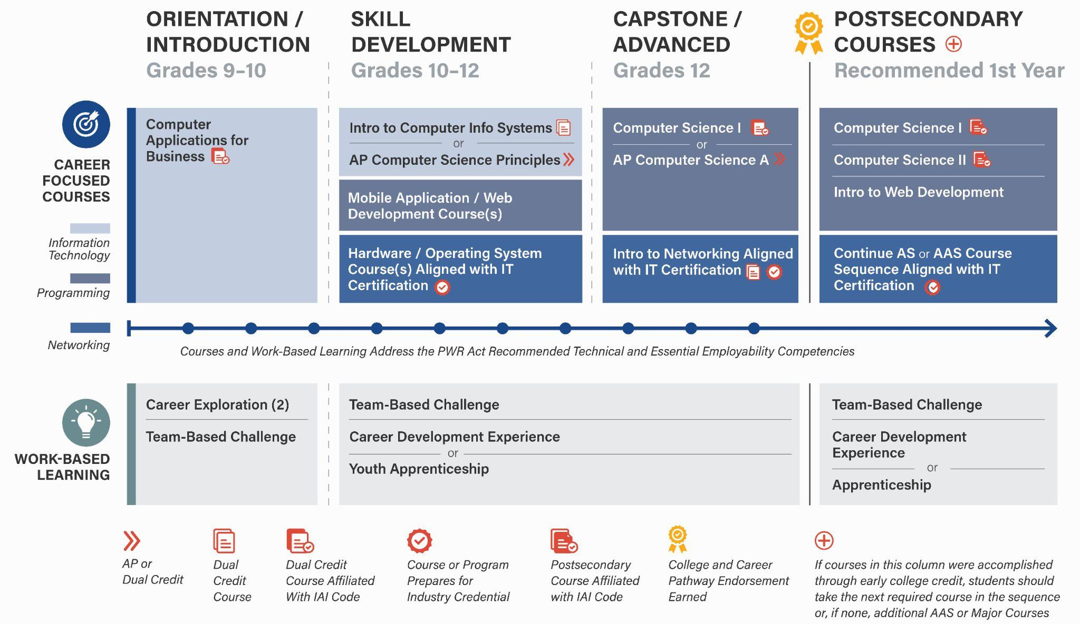
Notes:
JJG

Slide 14
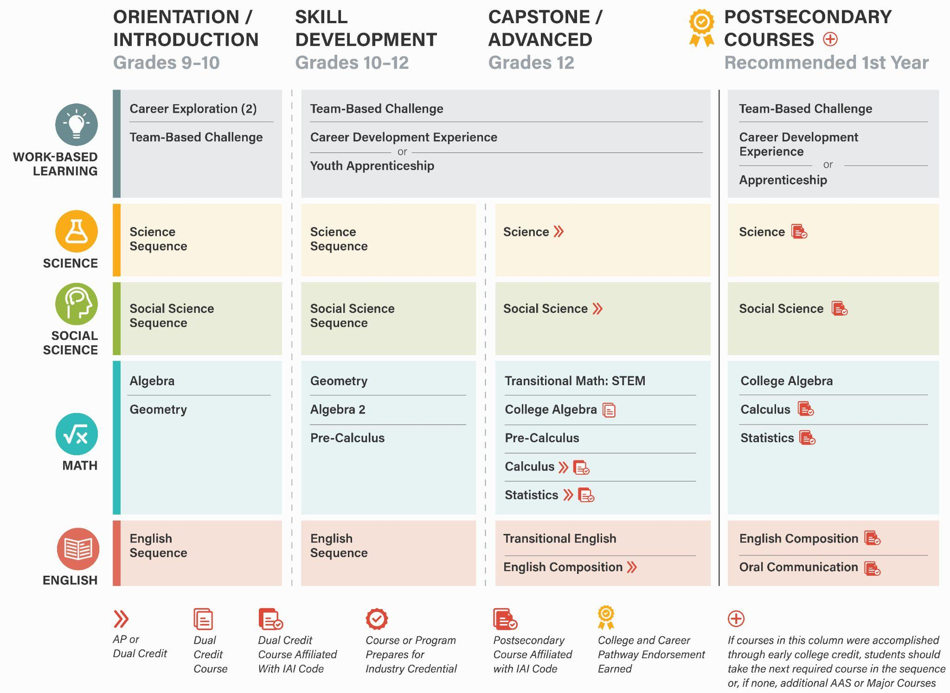
Notes:
JJG
Aligned to ISBE CTE as well

Slide 15
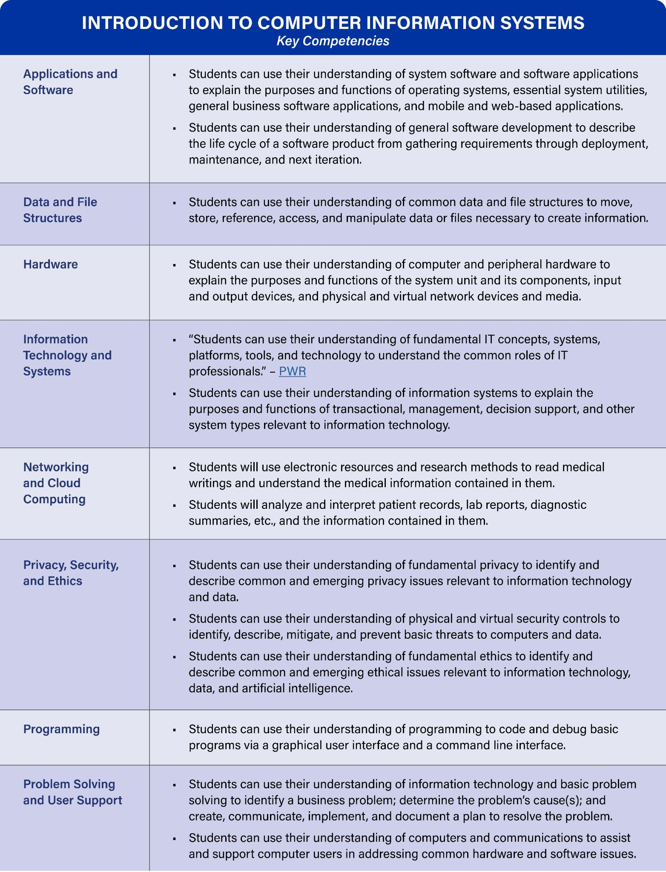
Strategic Dual Credit Course Competencies
Notes:
JJG
Multiple CC syllabi analyzed and synthesized

Slide 16
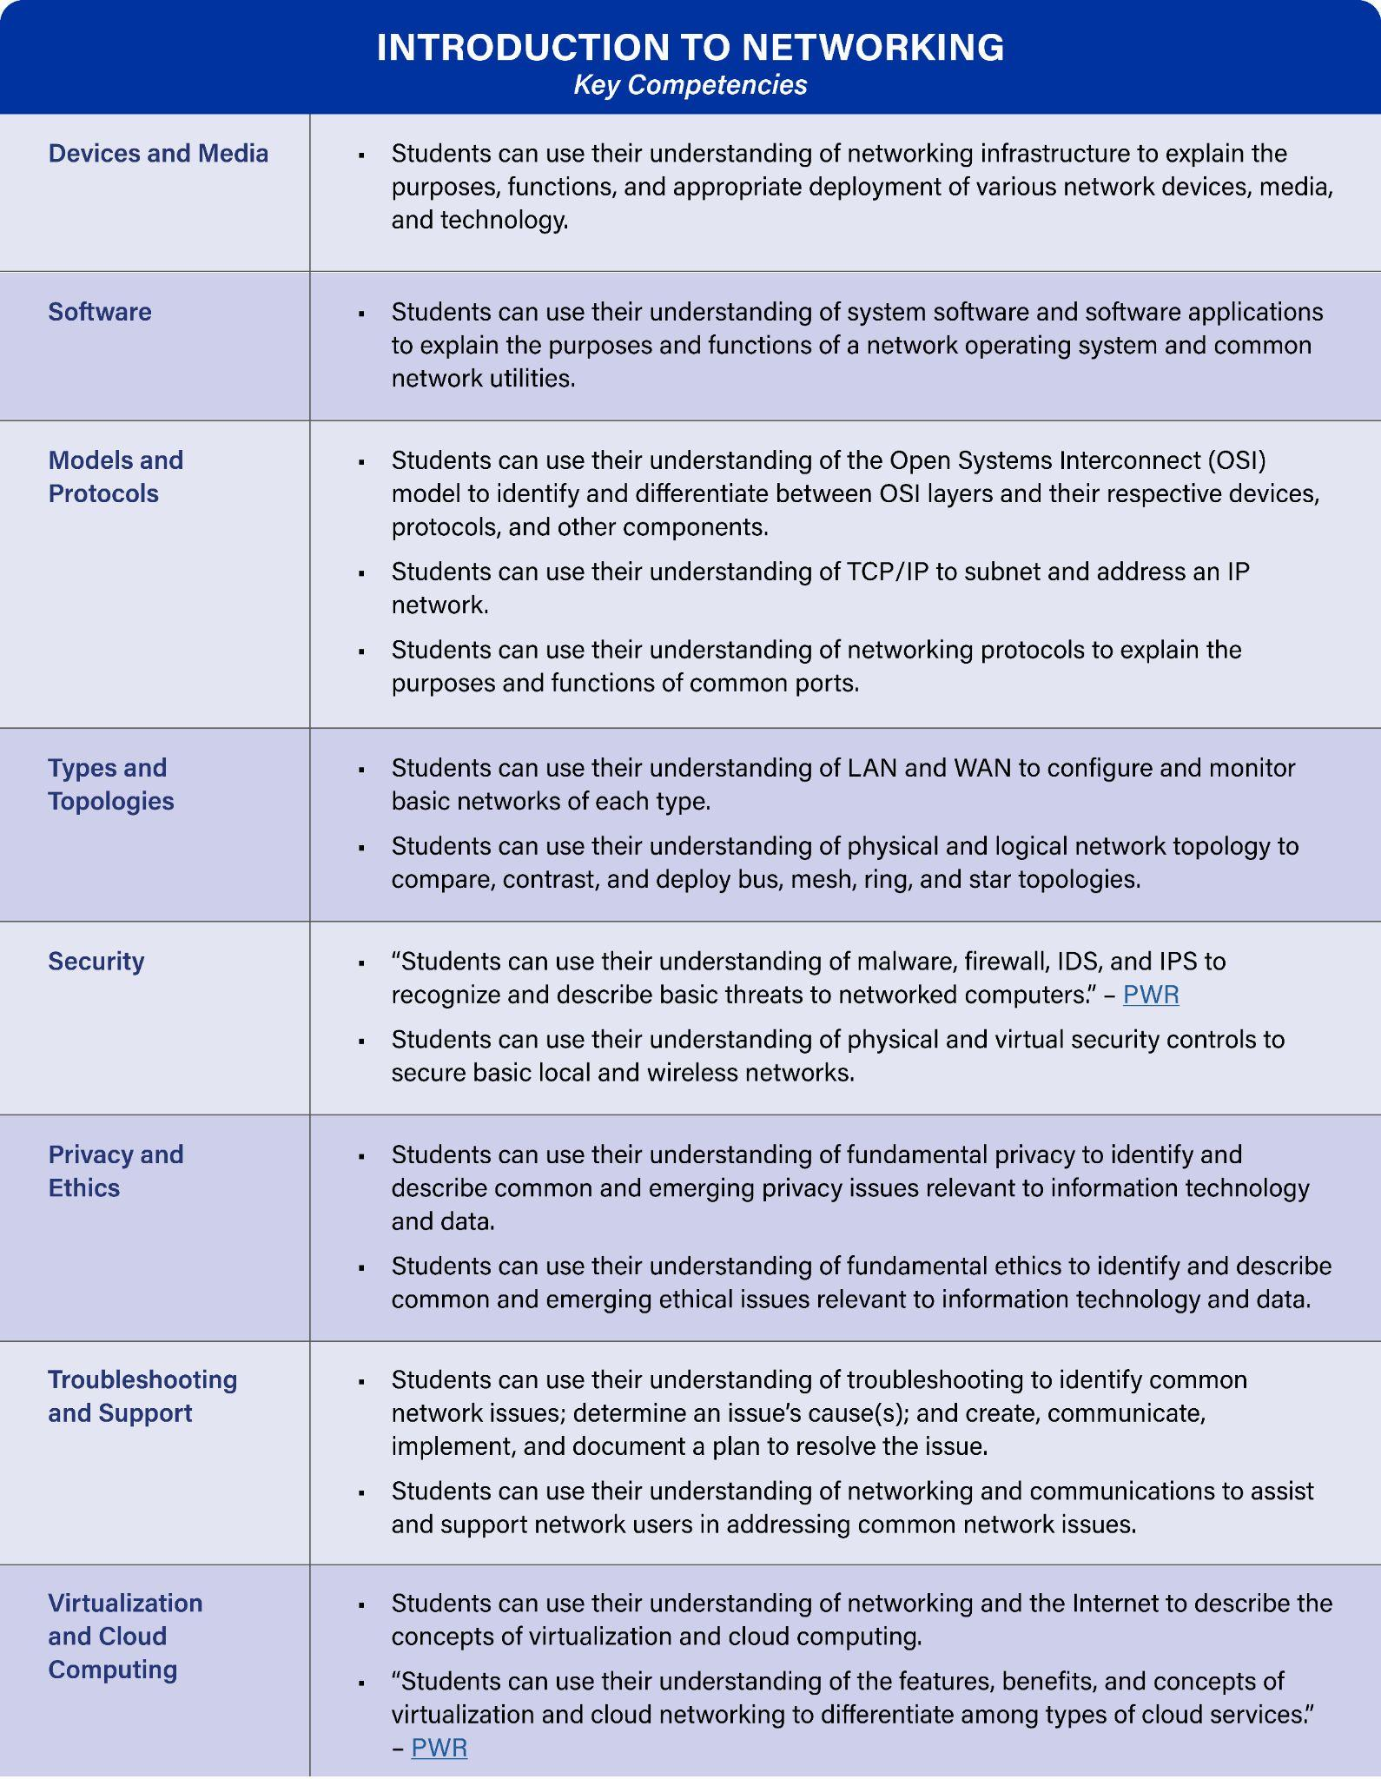
Strategic Dual Credit Course Competencies
Notes:
JJG
Multiple CC syllabi analyzed and synthesized

